Slide 1


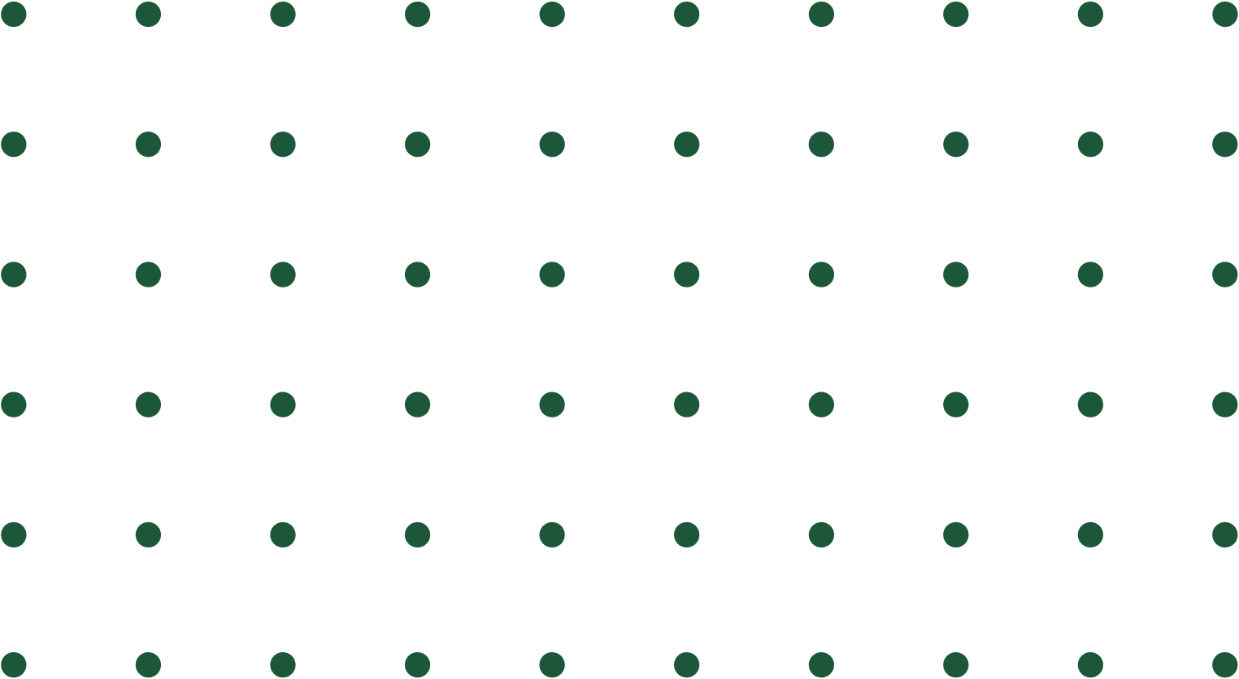
Personalized Stress Management Application Using Ayurvedic Practices and Creative Therapies.
24-25J-180

Slide 2

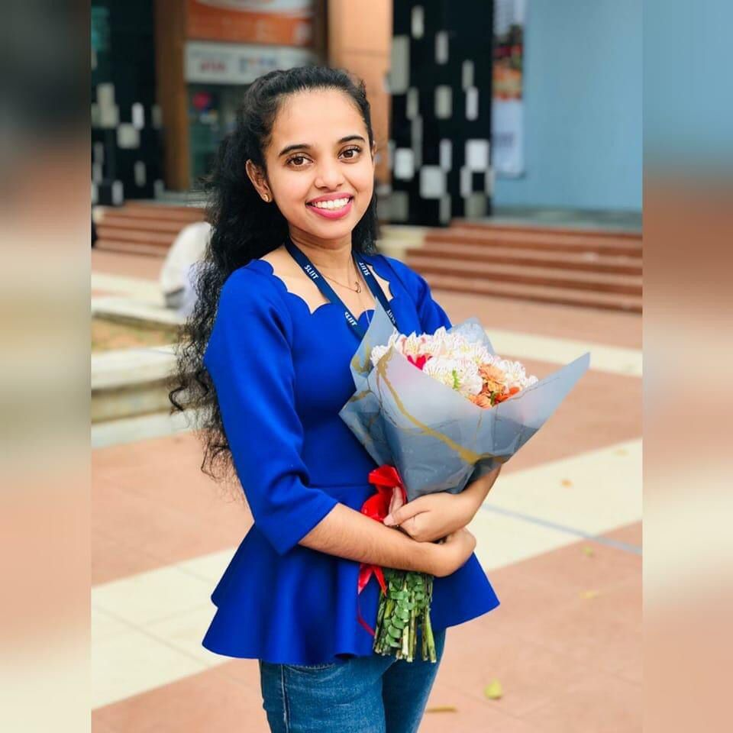
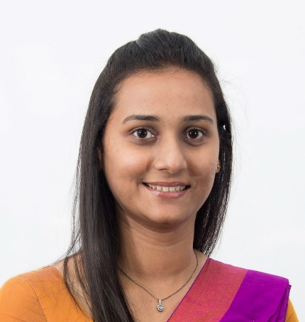
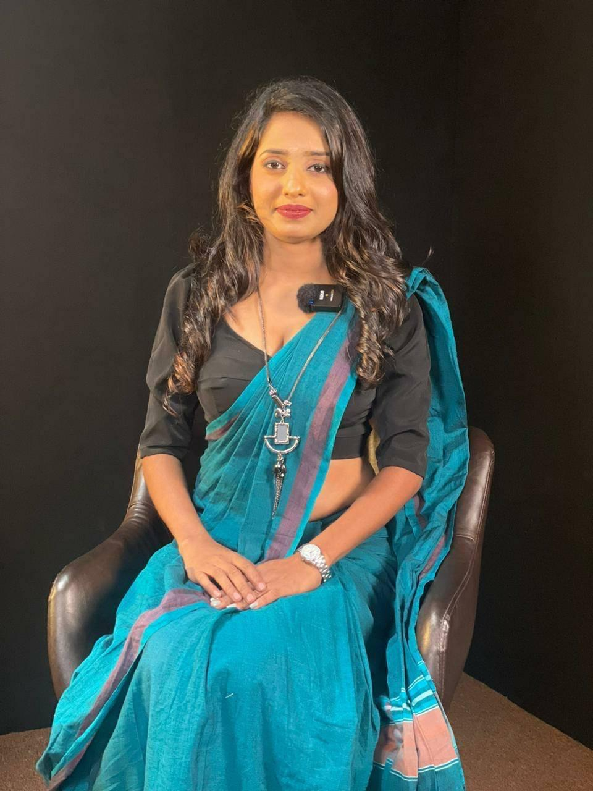
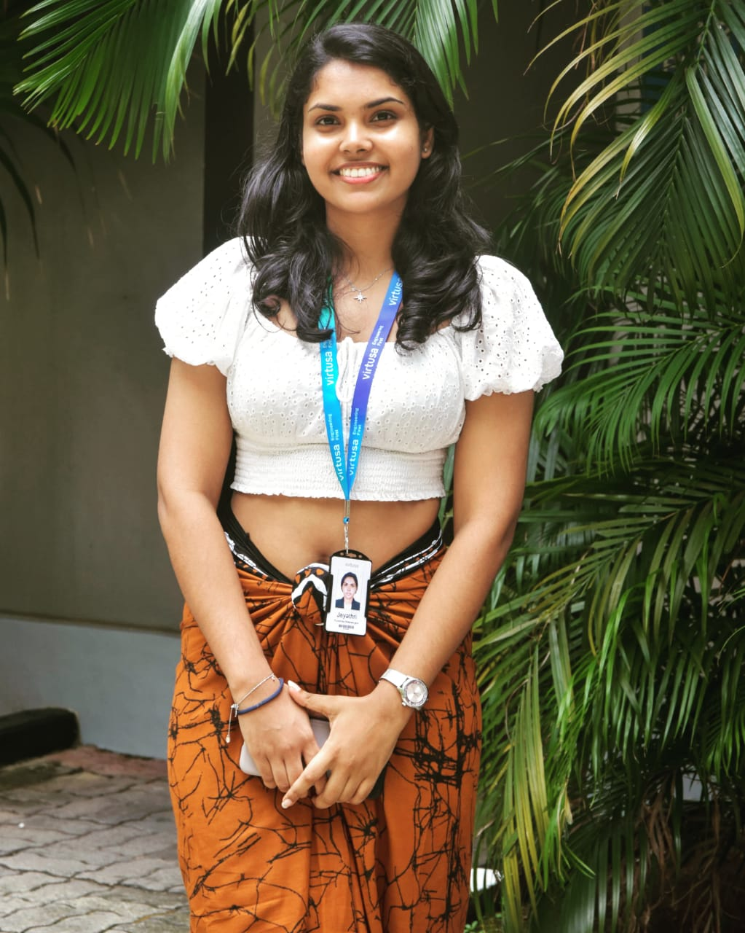
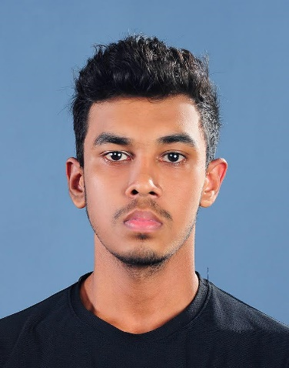
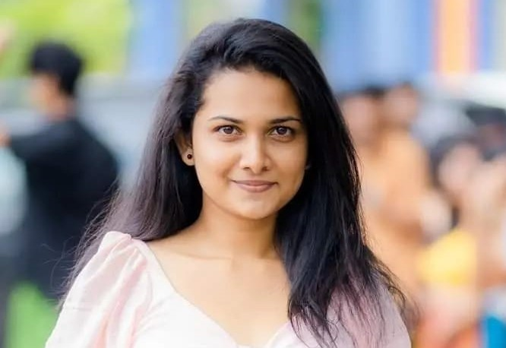
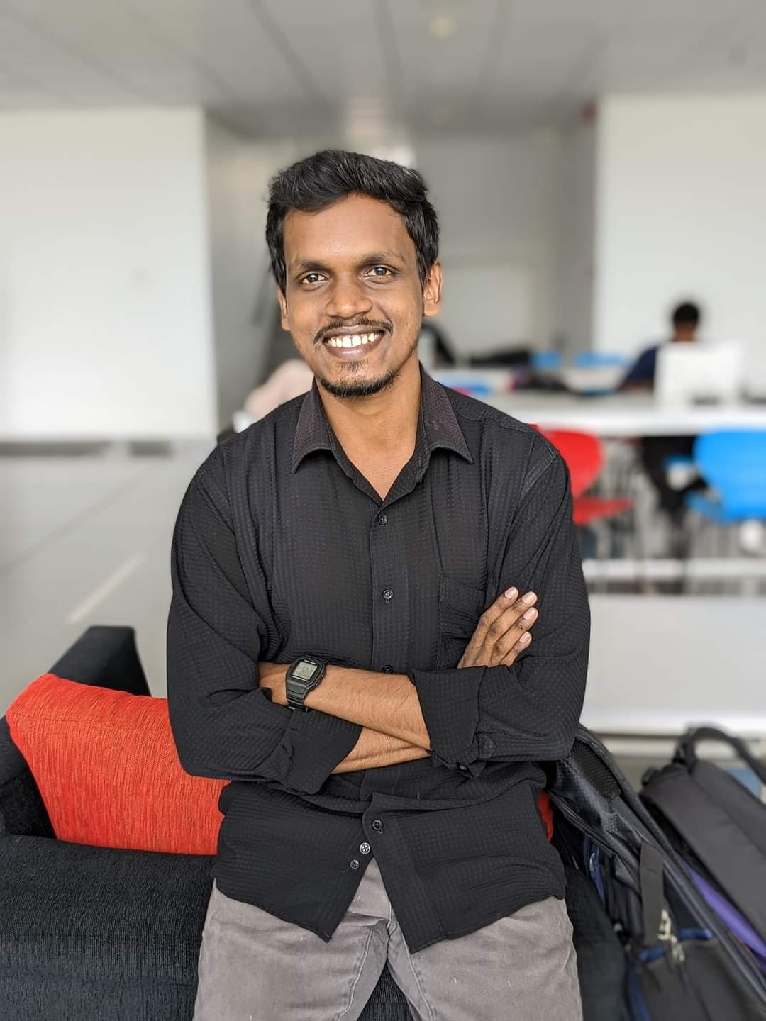
OUR TEAM
Supervisor
Ms. Pipuni wijesiri
Co –supervisor
Ms. Thamali Dassanayake
External supervisor
Dr. M. Kooragoda
Group Leader
Weerasinghe W.P.D.J.N.
Wickramasinghe B.G.W.M.C.R.
Jayathunge K.A.D.T.R.
Gunasekera H.D.P.M.

Slide 3

Content
01.
02.
03.
04.
05.
06.
07.
08.
09.
10.
Introduction
Research Question
Main Objective
Sub Objectives
System Overview Diagram
Individual Components Section
Current Progress
Future works
Appendix

Slide 4


INTRODUCTION
Stress is a natural human response that prompts us to address challenges and threats in our lives.
The way we respond to stress, makes a big difference to our overall well-being.
STRESS
Acute
Chronic
Episodic

Slide 5
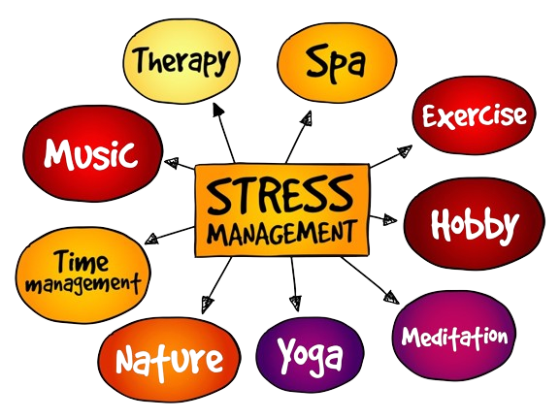
INTRODUCTION
Cont.
Ayurveda effectively reduces stress by promoting relaxation, emotional regulation, and overall mental well-being.

Slide 6

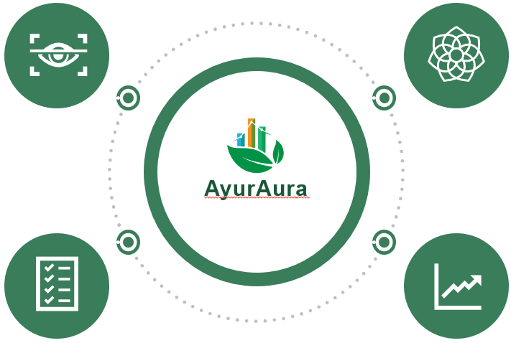
Main Objective
To provide a personalized stress management solution by integrating AI-driven biometric analysis with Ayurvedic practices, offering tailored treatment plans and activities to enhance mental health and well-being through non-pharmaceutical interventions.

Slide 7
Sub Objectives
01
To detect stress levels using AI algorithms for eye analysis, combined with a standard Ayurvedic questionnaire.
To develop a dynamic mobile module offering a set of stress-relief activities and predicting users’ current stress levels based on their engagement according to each activity.
02
03
To leverage machine learning to predict future stress through behavioral analysis and chatbot support.
To develop a dynamic system for personalized stress management, capable of projecting a timeline for achieving a stress-free state, tracking daily mood changes and visualizing progress.
04

Slide 8

System
Overview

Slide 9
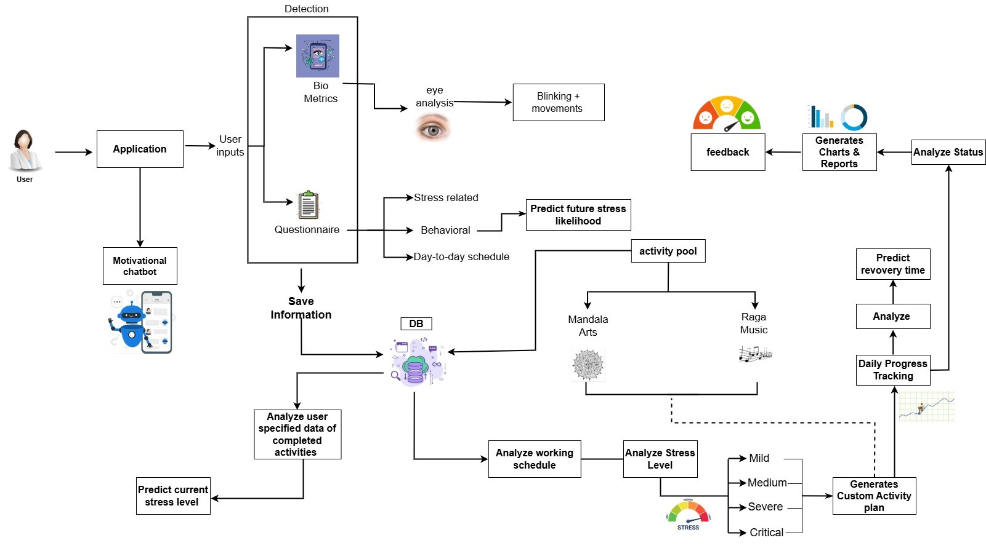

Slide 10

Individual components

Slide 11
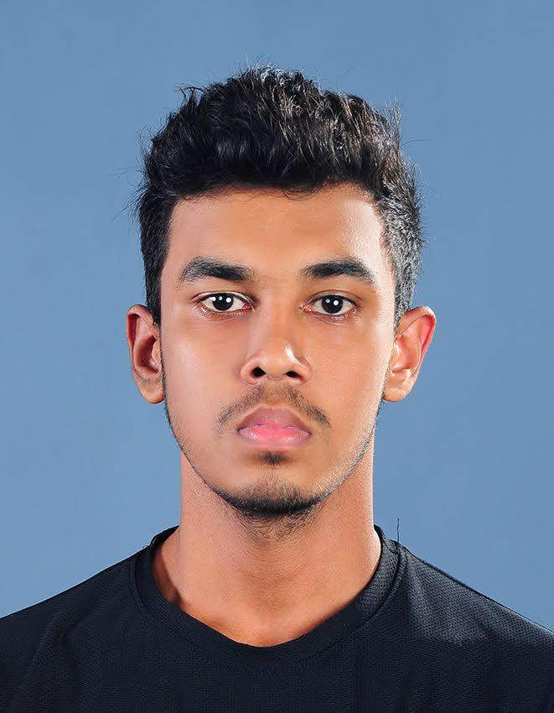
IT21279652|wickramasinghe b.g.w.m.c.r.
Information Technology
IT21279652 | Wickramasinghe B.G.W.M.C.R. | 24-25J-180

Slide 12
Integrating Eye movements and Questionnaire Analysis for Real-Time Stress Level Detection
Component 01
IT21279652 | Wickramasinghe B.G.W.M.C.R. | 24-25J-180

Slide 13
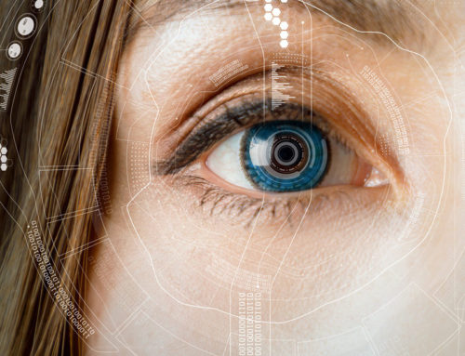
Background
enhances stress detection using a questionnaire, eye analysis to assess stress levels accurately.
The eye analysis examines the blinking and movements of the eye.
IT21279652 | Wickramasinghe B.G.W.M.C.R. | 24-25J-180

Slide 14




Objective
Sub Objectives
To detect stress levels using AI algorithms for eye combined with a standard Ayurvedic questionnaire.
To collect and preprocess multi-modal data.
To develop stress detection models.
To integrate stress detection methods.
To integrate the system and develop a mobile application
IT21279652 | Wickramasinghe B.G.W.M.C.R. | 24-25J-180

Slide 15
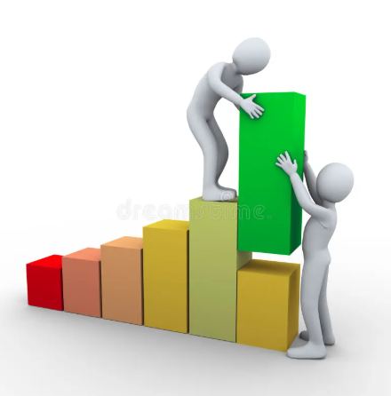
Progress in PP1

Slide 16
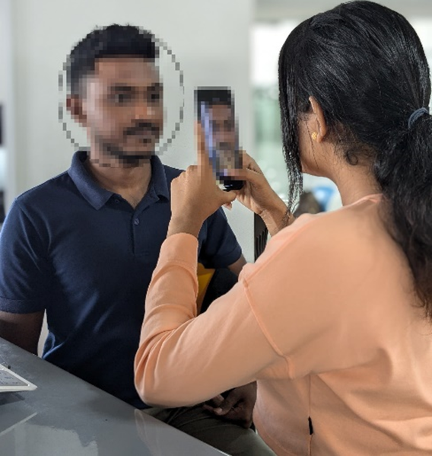
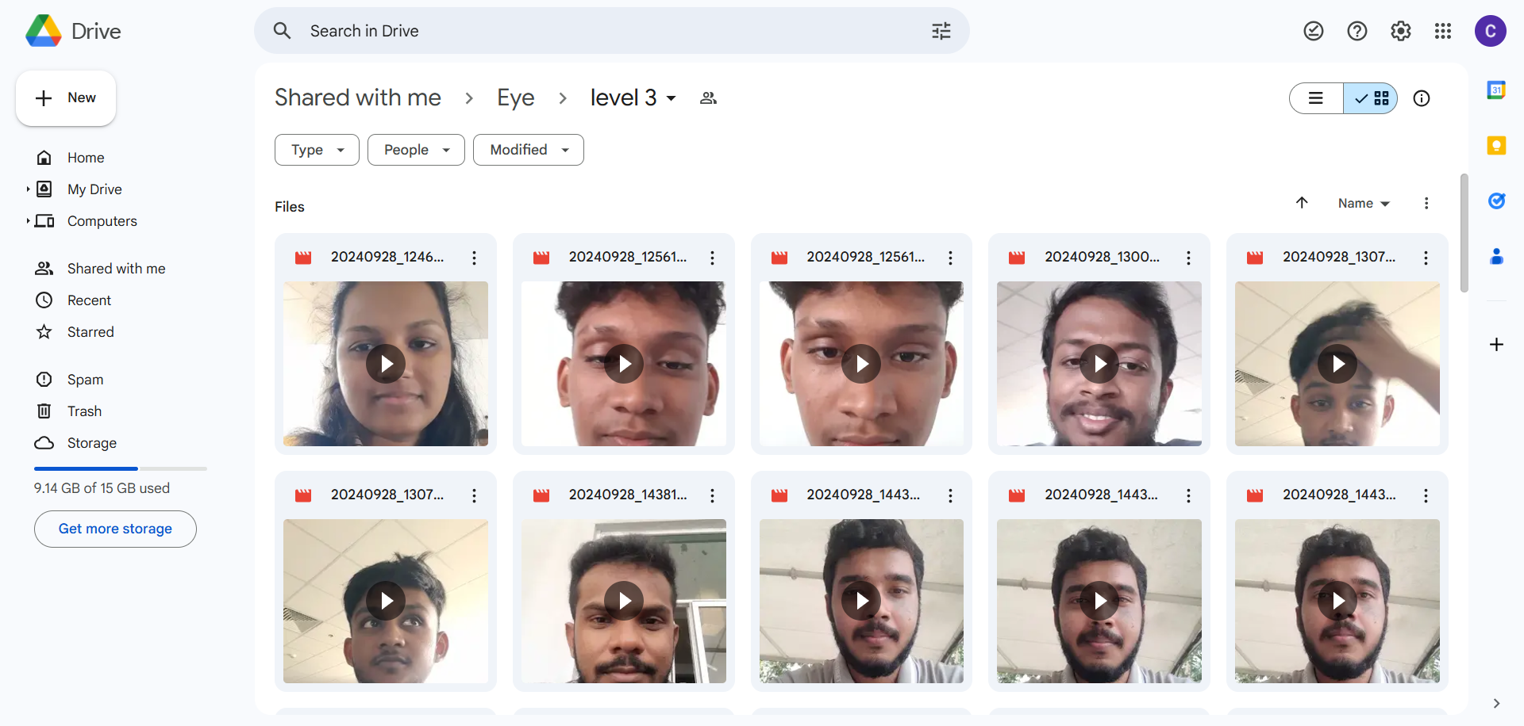
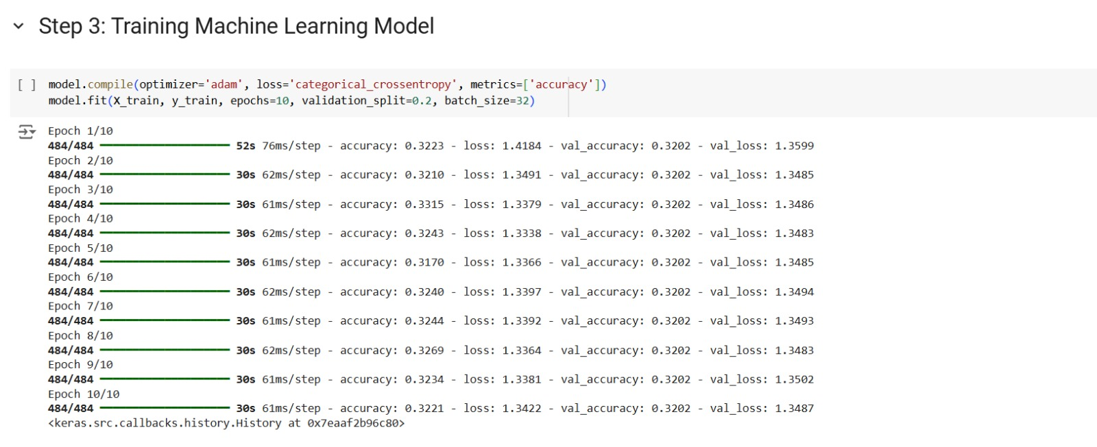
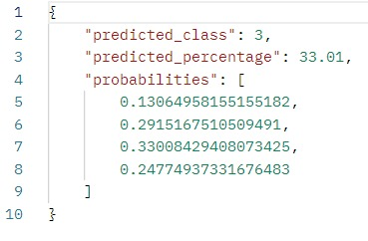
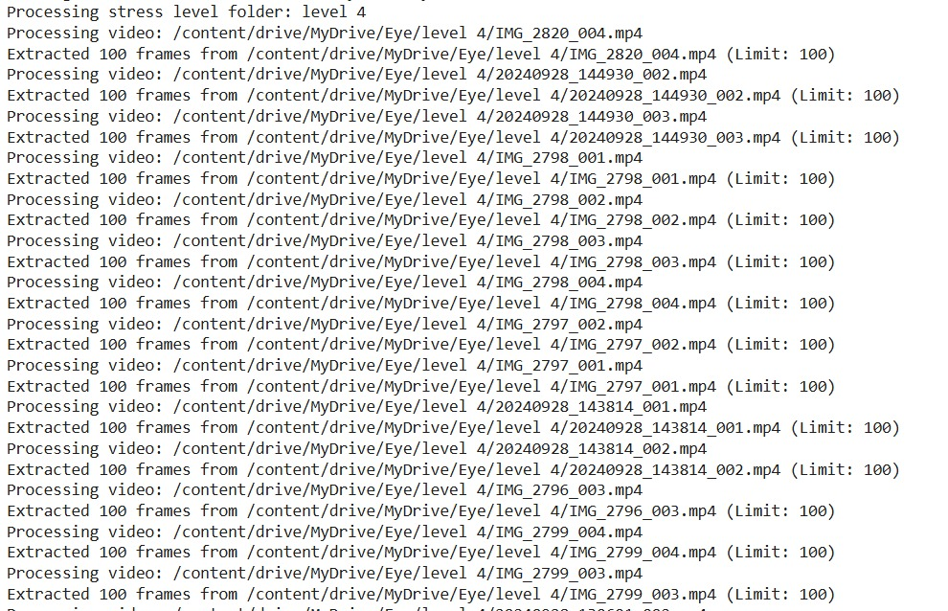
Model Training
Collected data
Collecting data
Training the model
Output
IT21279652 | Wickramasinghe B.G.W.M.C.R. | 24-25J-180

Slide 17
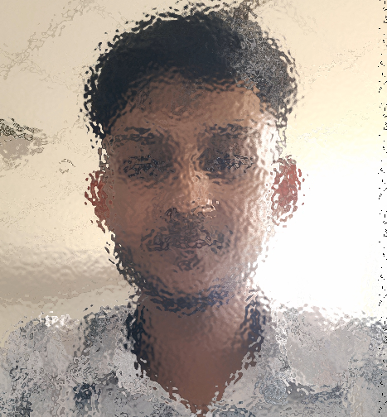

Model Training
Initial stress level
IT21279652 | Wickramasinghe B.G.W.M.C.R. | 24-25J-180

Slide 18
Frontend Implementation
IT21279652 | Wickramasinghe B.G.W.M.C.R. | 24-25J-180

Slide 19







Tools & Technologies

Slide 20
References
[1] Alexandra I. Korda, Giorgos Giannakakis ,Errikos Ventouras ,Pantelis A. Asvestas, Nikolaos Smyrnis,Kostas Marias ,George K. Matsopoulos, "Recognition of Blinks Activity Patterns during Stress Conditions Using CNN and Markovian Analysis," pp. 55-71, 2021.
[2] Aravind M S, Sri Bhavan Prakath, Tarunika R, Dr M.Srividya, Dr M.Marimuthu and Dr S.GayathriDevi, "Heart-Mind Harmony: Predicting Stress from Heart Rate," GRENZE International Journal of Engineering and Technology, vol. 10, no. 2, pp. 4181-4187.
[3] C. Jyotsna, Amudha J., "Eye Gaze as an Indicator for Stress Level Analysis in Students," ResearchGate, 2018.
[4] Simon Julier, Youngjun Cho, Nadia Bianchi-Berthouze, "DeepBreath: Deep Learning of Breathing Patterns for Automatic Stress Recognition using Low-Cost Thermal Imaging in Unconstrained Settings," ResearchGate, 2017.
[5] Valentina Perciavalle , Marta Blandini , Paola Fecarotta , Andrea Buscemi , Donatella Di Corrado , Luana Bertolo , Fulvia Fichera , Marinella Coco , "The role of deep breathing on stress," https://pubmed.ncbi.nlm.nih.gov/, vol. 38(3), pp. 451-458., 2017.
[6] MANSOUREH SEYED YOUSEFI, FARNOUSH REISI,MOHAMMAD REZA DALIRI , (Member, IEEE),AND VAHID SHALCHYAN, "Stress Detection Using Eye Tracking Data: An Evaluation of Full Parameters," ResearchGate, pp. PP(99):1-1, 2022.
IT21279652 | Wickramasinghe B.G.W.M.C.R. | 24-25J-180

Slide 21
References
[6] W. T.-M. H. a. S. U. (MSD), "Doing What Matters in Times of Stress:An Illustrated Guide," World Health Organization, 29 April 2020.
[7] "How to manage and reduce stress," Mental Health Foundathion, [Online]. Available: https://www.mentalhealth.org.uk/explore-mental-health/publications/how-manage-and-reduce-stress.
[8] Lily Martin, Renate Oepen, Katharina Bauer, Alina Nottensteiner, Katja Mergheim, Harald Gruber,and Sabine C. Koch, "Creative Arts Interventions for Stress Management and Prevention—A Systematic Review," Behav Sci (Basel), vol. 8, no. 2, p. 28, 2018 Feb.
[9] Chan-Woo Park, Sung Wook Seo, Noeul Kang, BeomSeok Ko, Byung Wook Choi, Chang Min Park, Dong Kyung Chang, Hwiuoung Kim, Hyunchul Kim, Kwang Joon Kim,Kyu-Hwan Jun, "Artificial Intelligence in Health Care: Current Applications and Issues," J Korean Med Sci., p. 35(42): e379., 2020 Nov 2.
[10]T. Worth, "Ayurveda: Does It Really Work?," 23 November 2023. [Online]. Available: https://www.webmd.com/balance/ayurvedic-treatments.
[11] Ashutosh Chauhan, Deepak Kumar Semwal, Satyendra Prasad Mishra, and Ruchi Badoni Semwal, "Ayurvedic research and methodology: Present status and future strategies," Ayu, vol. 36, no. 4, p. 364–369., 2015 Oct-Dec.
[12] Mary Catherine Bushnell, Eleni Frangos, and Nicholas Madian, "Non-pharmacological Treatment of Pain: Grand Challenge and Future Opportunities," Front Pain Res (Lausanne)., vol. 2, 2021.
IT21279652 | Wickramasinghe B.G.W.M.C.R. | 24-25J-180

Slide 22
jayathunge k.a.d.t.r.| it21162732
Information Technology
IT21162632 | Jayathunge K.A.D.T.R. | 24-25J-180

Slide 23
Developing an Activity Pool and Real-Time Stress Level Detection Based on Activity Patterns.
Component 02
IT21162632 | Jayathunge K.A.D.T.R. | 24-25J-180

Slide 24
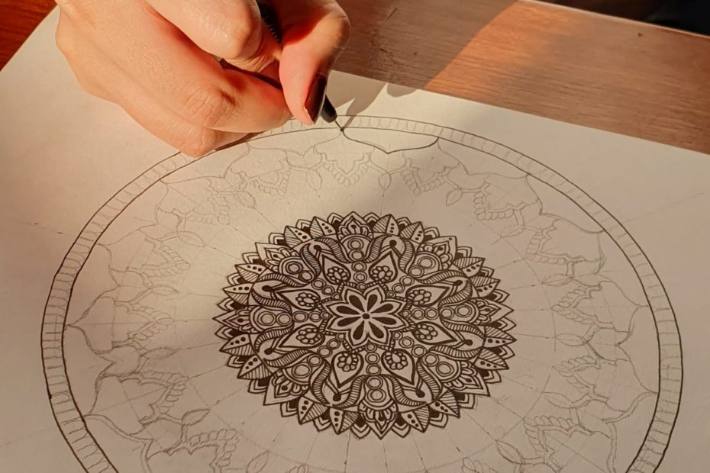
Background
Offers a diverse collection of activities (Mandala paintings, music therapy)
Predict stress level based on activity performance
IT21162632 | Jayathunge K.A.D.T.R. | 24-25J-180

Slide 25



Objective
Sub Objectives
To develop a module offering stress-relief activities and predicting users' stress levels based on their engagement.
Design and Develop Activity Modules.
Implement User Engagement Tracking
Develop Stress Level Prediction Model
Integrate System and Develop Mobile Application
IT21162632 | Jayathunge K.A.D.T.R. | 24-25J-180

Slide 26
Progress in PP1

Slide 27
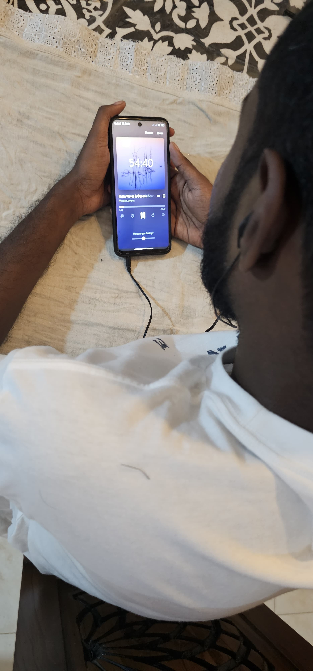
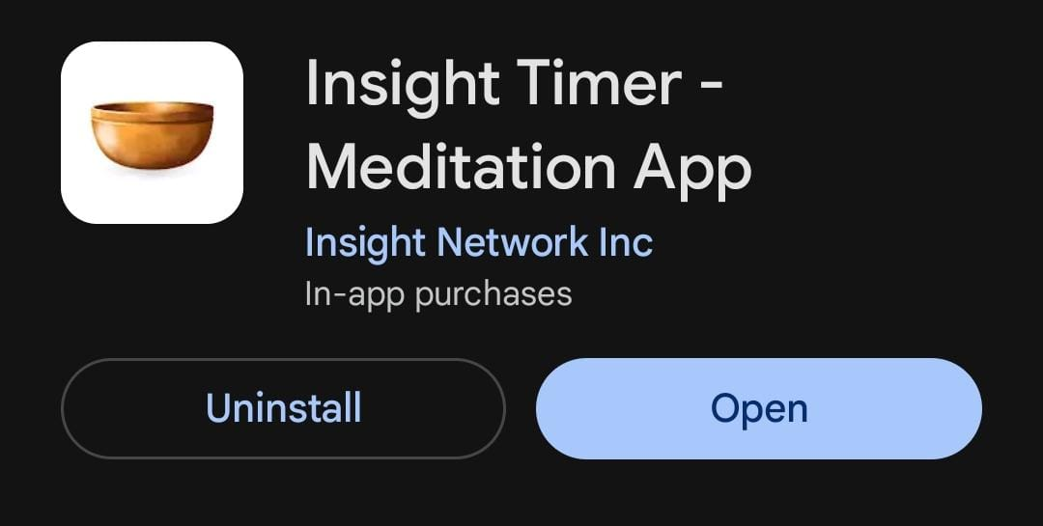
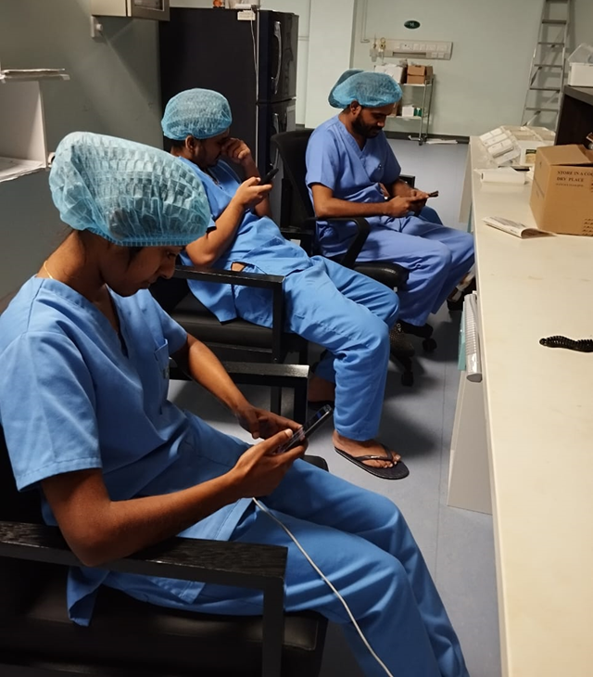
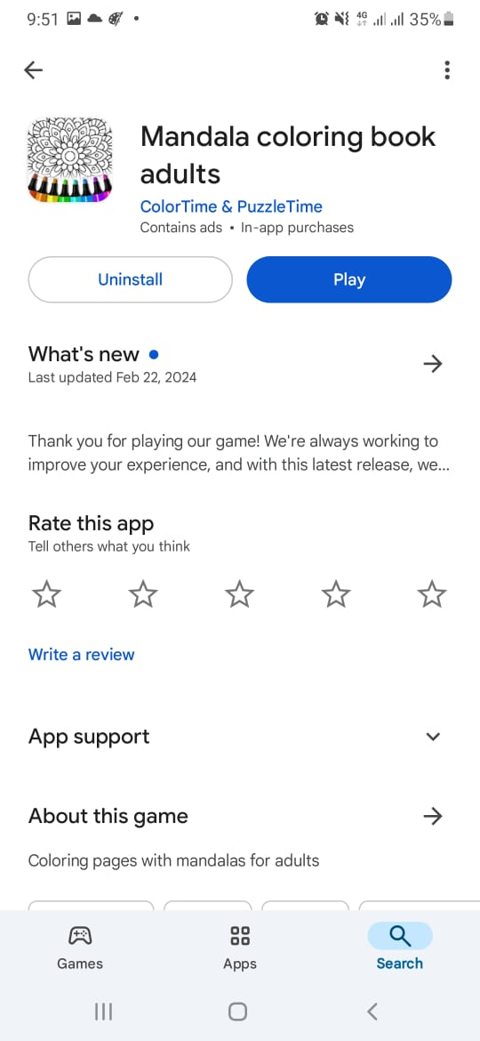
Model Development
Collecting data
IT21162632 | Jayathunge K.A.D.T.R. | 24-25J-180

Slide 28
Current Progress
Training the model
Output
IT21162632 | Jayathunge K.A.D.T.R. | 24-25J-180

Slide 29
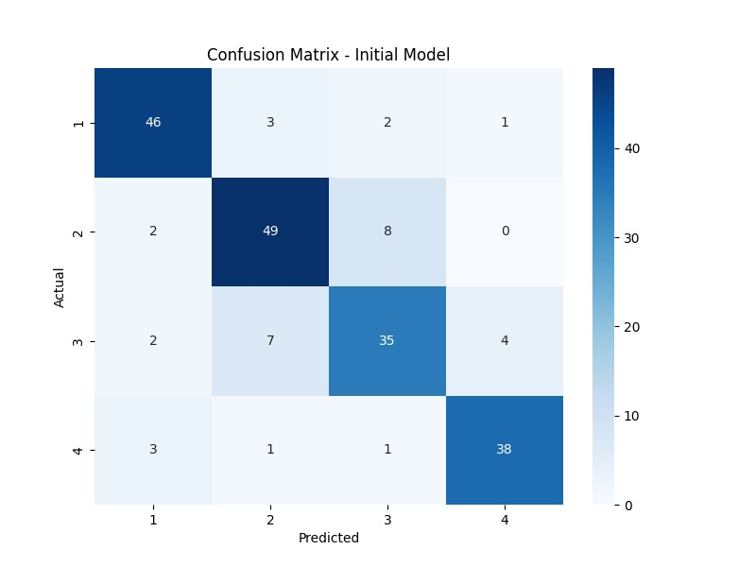
Current Progress
IT21162632 | Jayathunge K.A.D.T.R. | 24-25J-180

Slide 30
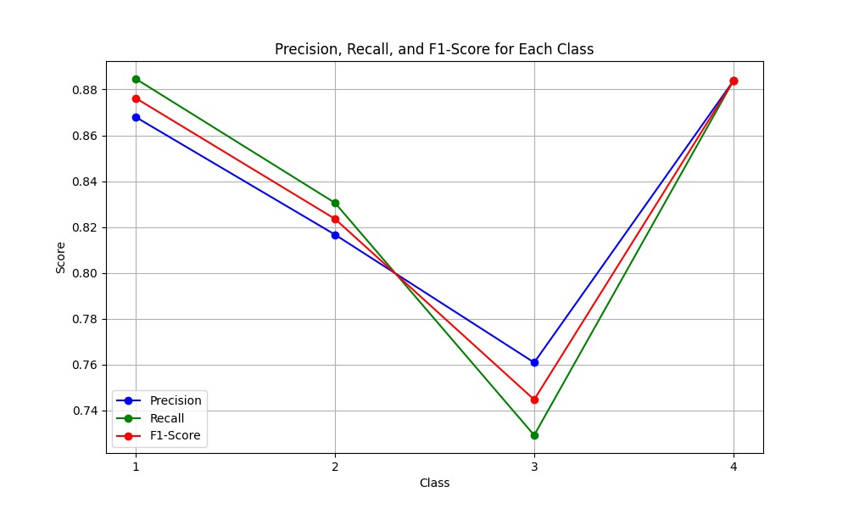
Current Progress
IT21162632 | Jayathunge K.A.D.T.R. | 24-25J-180

Slide 31
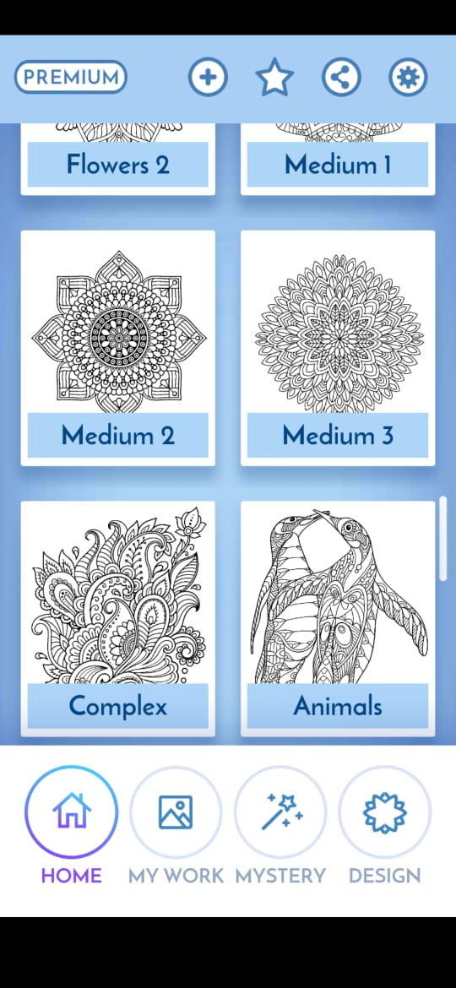
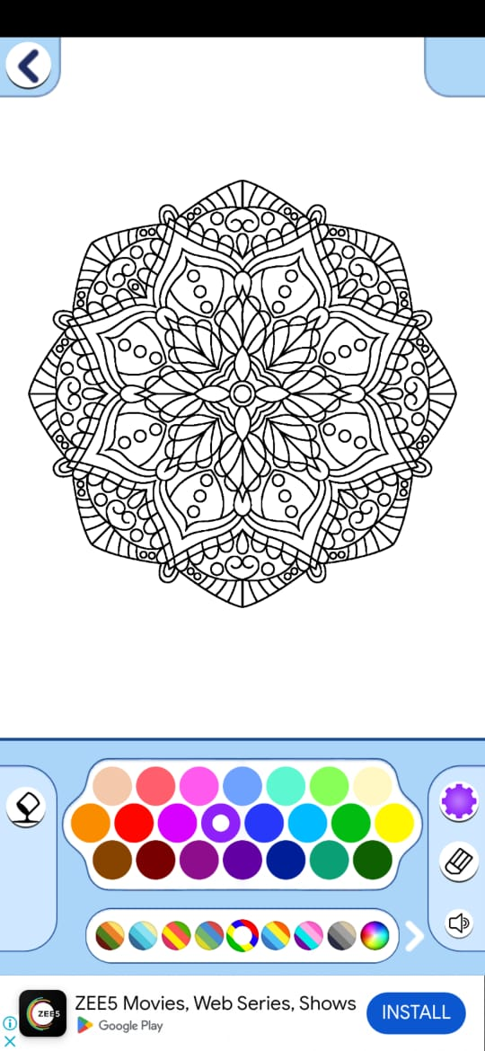
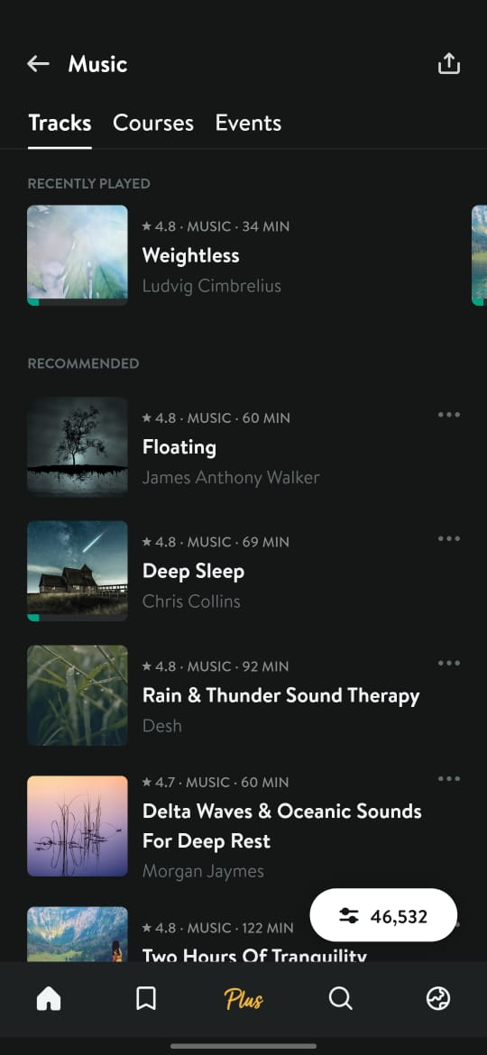
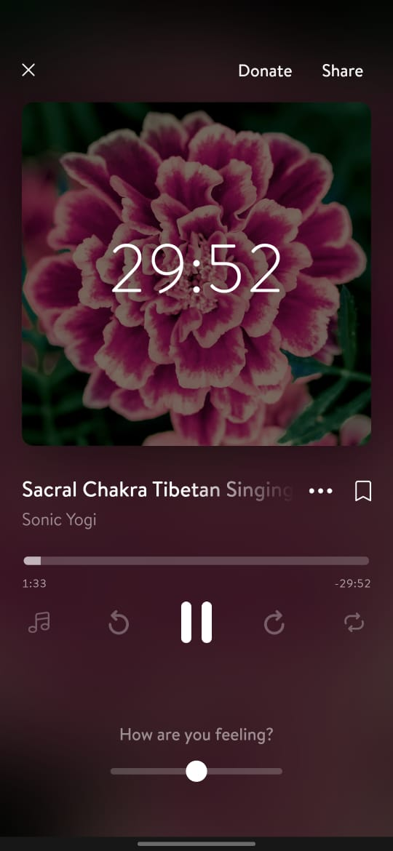
Future work
Develop mobile application
Implement User Engagement Tracking
IT21162632 | Jayathunge K.A.D.T.R. | 24-25J-180

Slide 32
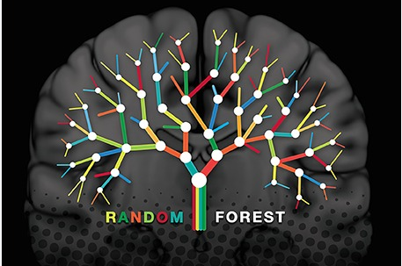
Tools & Technologies

Slide 33
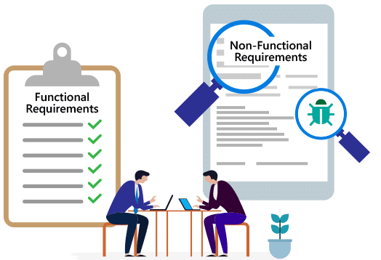
Functional Requirements
Non-Functional Requirements
Offer diverse stress-relief activities (e.g., art, music)
Track progress for each activity.
Update stress level based on activity completion.
Real-time, responsive activity tracking.
Dynamic stress level updates.
Accessible activities without extra equipment.
Simple, engaging feedback mechanism.
IT21162632 | Jayathunge K.A.D.T.R. | 24-25J-180

Slide 34
References
[1] | Yekta Said Can, Heather Iles-Smith, Niaz Chalabianloo, Deniz Ekiz, Javier Fernández-Álvarez, Claudia Repetto, Giuseppe Riva, and Cem Ersoy, "How to Relax in Stressful Situations: A Smart Stress Reduction System," Health care, vol. 8(2): , p. 100., 2020 Jun.
[2] | Soubhik Chakraborty, Avinav Prasad, Apoorva Chakraborty, Prerna Singh1, "Impact of Hindustani ragas in stress management: A statistical study," Journal of AppliedMath, vol. 1(1):, p. 143., 2023; .
[3] | Hyungsook Kim and Yoonyoung Choi, "A practical development protocol for evidence-based digital integrative arts therapy content in public mental health services: digital transformation of mandala art therapy," Front Public Health. , p. 11, 2023; .
[4] | "BetterSleep: Sleep tracker," [Online]. Available: https://play.google.com/store/apps/details?id=ipnossoft.rma.free&pli=1.
[5] | "meditative coloring," [Online]. Available: https://www.domestika.org/en/blog/9542-meditative-coloring-50-free-mandala-designs-for-coloring-in.
IT21162632 | Jayathunge K.A.D.T.R. | 24-25J-180

Slide 35
References
[6] W. T.-M. H. a. S. U. (MSD), "Doing What Matters in Times of Stress:An Illustrated Guide," World Health Organization, 29 April 2020.
[7] "How to manage and reduce stress," Mental Health Foundathion, [Online]. Available: https://www.mentalhealth.org.uk/explore-mental-health/publications/how-manage-and-reduce-stress.
[8] Lily Martin, Renate Oepen, Katharina Bauer, Alina Nottensteiner, Katja Mergheim, Harald Gruber,and Sabine C. Koch, "Creative Arts Interventions for Stress Management and Prevention—A Systematic Review," Behav Sci (Basel), vol. 8, no. 2, p. 28, 2018 Feb.
[9] Chan-Woo Park, Sung Wook Seo, Noeul Kang, BeomSeok Ko, Byung Wook Choi, Chang Min Park, Dong Kyung Chang, Hwiuoung Kim, Hyunchul Kim, Kwang Joon Kim,Kyu-Hwan Jun, "Artificial Intelligence in Health Care: Current Applications and Issues," J Korean Med Sci., p. 35(42): e379., 2020 Nov 2.
[10]T. Worth, "Ayurveda: Does It Really Work?," 23 November 2023. [Online]. Available: https://www.webmd.com/balance/ayurvedic-treatments.
[11] Ashutosh Chauhan, Deepak Kumar Semwal, Satyendra Prasad Mishra, and Ruchi Badoni Semwal, "Ayurvedic research and methodology: Present status and future strategies," Ayu, vol. 36, no. 4, p. 364–369., 2015 Oct-Dec.
[12] Mary Catherine Bushnell, Eleni Frangos, and Nicholas Madian, "Non-pharmacological Treatment of Pain: Grand Challenge and Future Opportunities," Front Pain Res (Lausanne)., vol. 2, 2021.
IT21162632 | Jayathunge K.A.D.T.R. | 24-25J-180

Slide 36
Gunasekera h.d.p.m. | it21161674
Information Technology
IT21161674 | Gunasekera H.D.P.M. | 24-25J-180

Slide 37
Predicting Future Stress Likelihood and a Motivational Chatbot.
Component 03
IT21161674 | Gunasekera H.D.P.M. | 24-25J-180

Slide 38

Background
Uses machine learning to predict future stress by analyzing behavioral patterns like sleep, exercise, and screen time without the need for wearable devices.
Create a motivational chatbot designed to support users.
IT21161674 | Gunasekera H.D.P.M. | 24-25J-180

Slide 39


Objective
Sub Objectives
To leverage machine learning to predict future stress likelihood via behavioral data analysis, develop a motivational chatbot, empowering proactive stress management and well-being.
To collect and preprocess diverse behavioral data.
To develop future stress likelihood prediction model.
To create motivational chatbot designed to support users.
To integrate the system, develop a mobile app, and conduct evaluations.
IT21161674 | Gunasekera H.D.P.M. | 24-25J-180

Slide 40
Progress in PP1

Slide 41
Current Progress
Collecting data
Training the model
Output
IT21161674 | Gunasekera H.D.P.M. | 24-25J-180

Slide 42
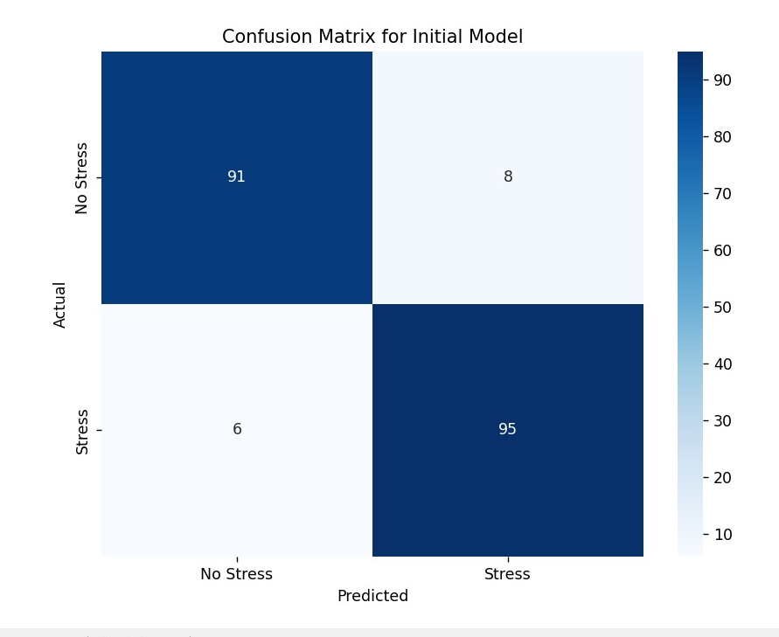
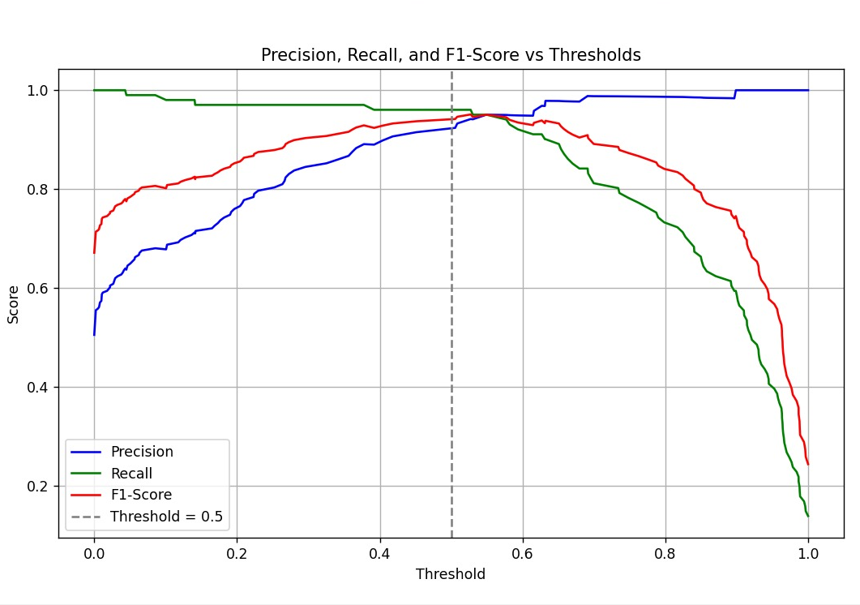
Current Progress

Slide 43
Develop chatbot
Develop frontend
Future work
IT21161674 | Gunasekera H.D.P.M. | 24-25J-180

Slide 44
Tools & Technologies

Slide 45
Functional Requirements
Non-Functional Requirements
Input behavioral data.
Predict future stress.
Recommend behavioral changes.
Include a motivational chatbot.
Chatbot available 24/7 with supportive responses.
Process data securely.
Process data quickly
Design an engaging, easy-to-navigate interface.
IT21161674 | Gunasekera H.D.P.M. | 24-25J-180

Slide 46
References
[1] | Laura S. P. Bloomfield, Mikaela I. Fudolig, Julia Kim, Juniper L. Lovato, Ellen W. McGinnis, Ryan S. McGinnis, Matt Price,Taylor H. Ricketts, Peter Sheridan Dodds, Kathryn Stanton and Christopher M. Danforth, "Predicting stress in first-year college students using sleep data from wearable devices," PubMed Central, 2024 Apr; 3(4): e0000473..
[2] | Ada ng, Boyang Wei , Jayalakshmi Jain , Erin A Ward , S Darius Tandon , Judith T Moskowitz , Sheila Krogh-Jespersen , Lauren S Wakschlag , Nabil Alshurafa , "Predicting the Next-Day Perceived and Physiological Stress of Pregnant Women by Using Machine Learning and Explainability: Algorithm Development and Validation," PubMed, p. 10(8):e33850. doi: 10.2196/33850, 2022 Aug 2;.
[3] | Luis G. Jaimes; Kanwalinderjit Gagneja; Mustafa İlhan Akbaş; Idalides J. Vergara-Laurens, "Future stress, forecasting physiological signals," IEEE, 2017.
[4] | "Headspace," [Online]. Available: https://www.headspace.com/.
[5] | "Calm," [Online]. Available: https://www.calm.com/.
[6] | "MyFitnessPal," [Online]. Available: https://myfitnesspal.com/.
IT21161674 | Gunasekera H.D.P.M. | 24-25J-180

Slide 47
References
[6] W. T.-M. H. a. S. U. (MSD), "Doing What Matters in Times of Stress:An Illustrated Guide," World Health Organization, 29 April 2020.
[7] "How to manage and reduce stress," Mental Health Foundathion, [Online]. Available: https://www.mentalhealth.org.uk/explore-mental-health/publications/how-manage-and-reduce-stress.
[8] Lily Martin, Renate Oepen, Katharina Bauer, Alina Nottensteiner, Katja Mergheim, Harald Gruber,and Sabine C. Koch, "Creative Arts Interventions for Stress Management and Prevention—A Systematic Review," Behav Sci (Basel), vol. 8, no. 2, p. 28, 2018 Feb.
[9] Chan-Woo Park, Sung Wook Seo, Noeul Kang, BeomSeok Ko, Byung Wook Choi, Chang Min Park, Dong Kyung Chang, Hwiuoung Kim, Hyunchul Kim, Kwang Joon Kim,Kyu-Hwan Jun, "Artificial Intelligence in Health Care: Current Applications and Issues," J Korean Med Sci., p. 35(42): e379., 2020 Nov 2.
[10]T. Worth, "Ayurveda: Does It Really Work?," 23 November 2023. [Online]. Available: https://www.webmd.com/balance/ayurvedic-treatments.
[11] Ashutosh Chauhan, Deepak Kumar Semwal, Satyendra Prasad Mishra, and Ruchi Badoni Semwal, "Ayurvedic research and methodology: Present status and future strategies," Ayu, vol. 36, no. 4, p. 364–369., 2015 Oct-Dec.
[12] Mary Catherine Bushnell, Eleni Frangos, and Nicholas Madian, "Non-pharmacological Treatment of Pain: Grand Challenge and Future Opportunities," Front Pain Res (Lausanne)., vol. 2, 2021.
IT21161674 | Gunasekera H.D.P.M. | 24-25J-180

Slide 48
weerasinghe w.p.d.j.n.| it21162664
Information Technology
IT21161664 | Weerasinghe W.P.D.J.N. | 24-25J-180

Slide 49
After prediction: Predictive Analytics for Achieving a Stress-Free State.
Component 04
IT21161664 | Weerasinghe W.P.D.J.N. | 24-25J-180

Slide 50

Background
Tracks daily emotions, and adherence with user-friendly inputs, notifications, and analytics for personalized stress management.
Features predictive timelines, rewards, and progress reports to enhance engagement and support users.
IT21161664 | Weerasinghe W.P.D.J.N. | 24-25J-180

Slide 51

Objective
Sub Objectives
To develop a dynamic system for personalized stress management, capable of projecting a timeline for achieving a stress-free state, tracking daily mood changes and visualizing progress.
To develop a model to predict the timeline to be stress-free
To track the progress of moods and energy levels
To create personalized feedbacks and notification system
To create a Reward and Recognition System to keep users engaged
IT21161664 | Weerasinghe W.P.D.J.N. | 24-25J-180

Slide 52
Progress in PP1

Slide 53
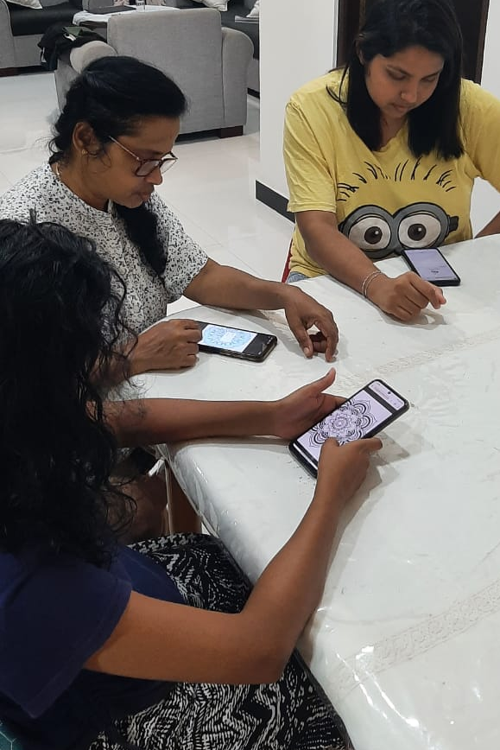
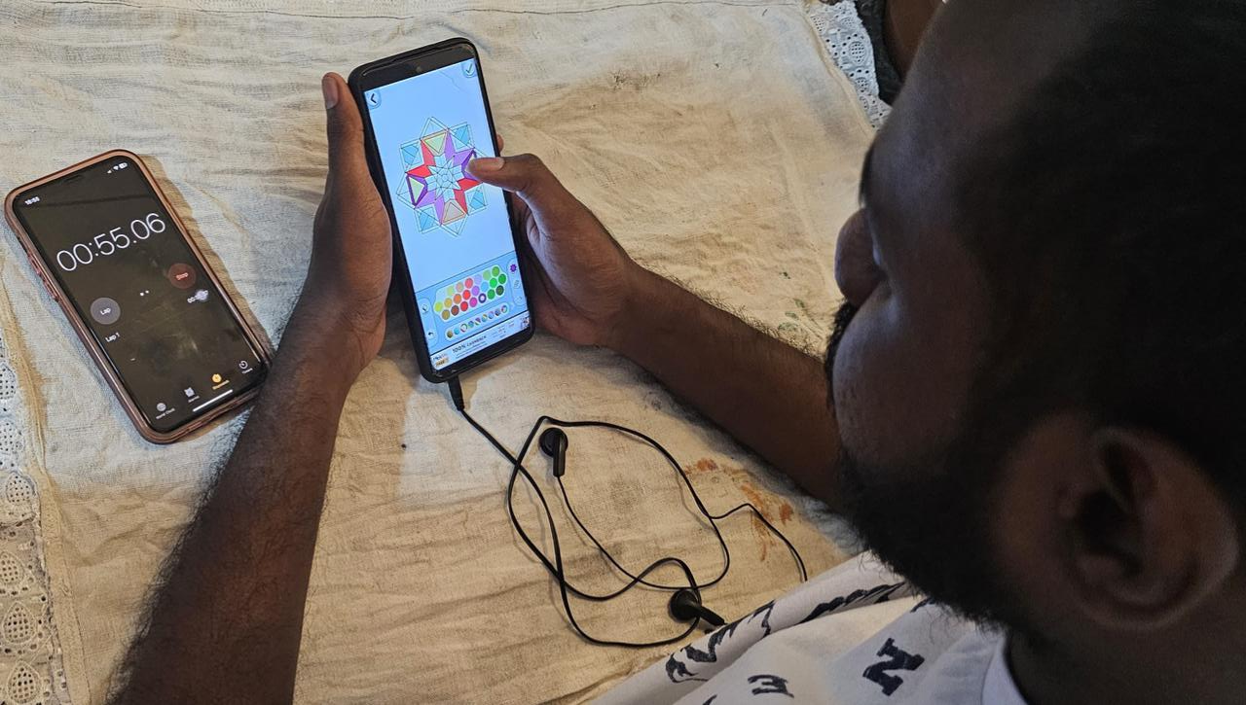
Current Progress
Collecting data
Data cleaning
IT21161664 | Weerasinghe W.P.D.J.N. | 24-25J-180

Slide 54
Current Progress
Training the model
Output
IT21161664 | Weerasinghe W.P.D.J.N. | 24-25J-180

Slide 55
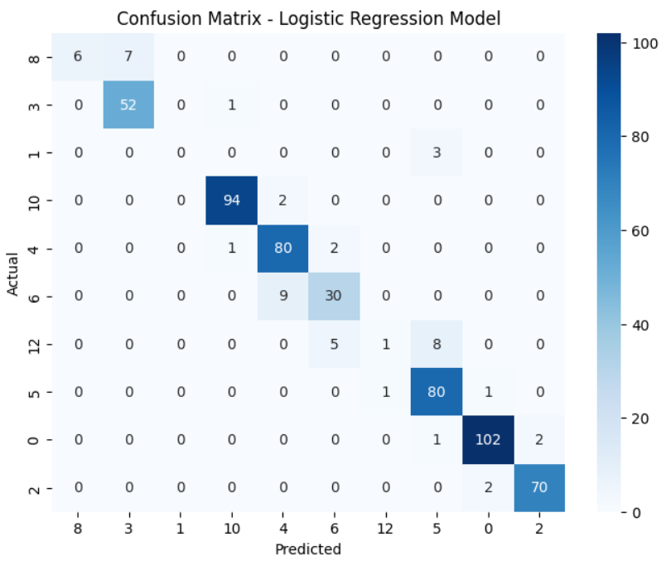
Current Progress
IT21161664 | Weerasinghe W.P.D.J.N. | 24-25J-180

Slide 56
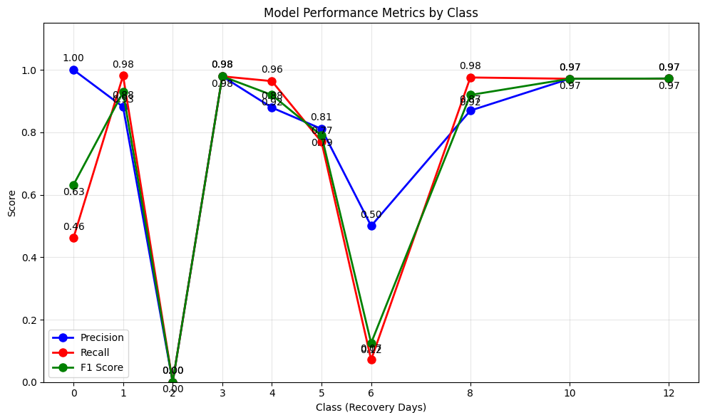
Current Progress
IT21161664 | Weerasinghe W.P.D.J.N. | 24-25J-180

Slide 57


Future work
feedbacks and notification system
Reward and Recognition System
IT21161664 | Weerasinghe W.P.D.J.N. | 24-25J-180

Slide 58
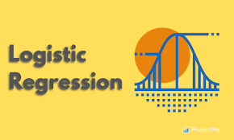
Tools & Technologies

Slide 59
Functional Requirements
Non-Functional Requirements
Allow entry of daily mood and energy.
Predict stress-free time based on data.
Display mood and energy stats in charts.
Provide personalized insights.
Allow notifications
Fast, easy data entry.
Timely predictions and insights.
Clear, interactive charts.
Secure user data.
IT21161664 | Weerasinghe W.P.D.J.N. | 24-25J-180

Slide 60
References
[1] | Melanie Bamert and Jennifer Inauen, "Physiological stress reactivity and recovery: Some laboratory results transfer to daily life," PubMed Central, 2022.
[2] | B. B. a. E. H.-J. Cindy Harmon-Jones, "The Discrete Emotions Questionnaire: A New Tool for Measuring State Self-Reported Emotions," PubMed Central, p. 11(8): e0159915., 2016.
[3] | Didace Ndahimana and Eun-Kyung Kim, "Measurement Methods for Physical Activity and Energy Expenditure: a Review," PubMed Central, vol. 6(2), p. 68–80, 2017 Apr.
[4] | SONJA LYUBOMIRSKY and HEIDI S. LEPPER, "A Measure of Subjective Happiness: Preliminary Reliability and Construct Validation," ResearchGate, pp. 46(2):137-155, 1999.
[5] | Cindy Harmon-Jones, Brock Bastian,and Eddie Harmon-Jones, "The Discrete Emotions Questionnaire: A New Tool for Measuring State Self-Reported Emotions," PubMed Central, 2016; 11(8): e0159915..
IT21161664 | Weerasinghe W.P.D.J.N. | 24-25J-180

Slide 61
References
[6] W. T.-M. H. a. S. U. (MSD), "Doing What Matters in Times of Stress:An Illustrated Guide," World Health Organization, 29 April 2020.
[7] "How to manage and reduce stress," Mental Health Foundathion, [Online]. Available: https://www.mentalhealth.org.uk/explore-mental-health/publications/how-manage-and-reduce-stress.
[8] Lily Martin, Renate Oepen, Katharina Bauer, Alina Nottensteiner, Katja Mergheim, Harald Gruber,and Sabine C. Koch, "Creative Arts Interventions for Stress Management and Prevention—A Systematic Review," Behav Sci (Basel), vol. 8, no. 2, p. 28, 2018 Feb.
[9] Chan-Woo Park, Sung Wook Seo, Noeul Kang, BeomSeok Ko, Byung Wook Choi, Chang Min Park, Dong Kyung Chang, Hwiuoung Kim, Hyunchul Kim, Kwang Joon Kim,Kyu-Hwan Jun, "Artificial Intelligence in Health Care: Current Applications and Issues," J Korean Med Sci., p. 35(42): e379., 2020 Nov 2.
[10]T. Worth, "Ayurveda: Does It Really Work?," 23 November 2023. [Online]. Available: https://www.webmd.com/balance/ayurvedic-treatments.
[11] Ashutosh Chauhan, Deepak Kumar Semwal, Satyendra Prasad Mishra, and Ruchi Badoni Semwal, "Ayurvedic research and methodology: Present status and future strategies," Ayu, vol. 36, no. 4, p. 364–369., 2015 Oct-Dec.
[12] Mary Catherine Bushnell, Eleni Frangos, and Nicholas Madian, "Non-pharmacological Treatment of Pain: Grand Challenge and Future Opportunities," Front Pain Res (Lausanne)., vol. 2, 2021.
IT21161664 | Weerasinghe W.P.D.J.N. | 24-25J-180

Slide 62
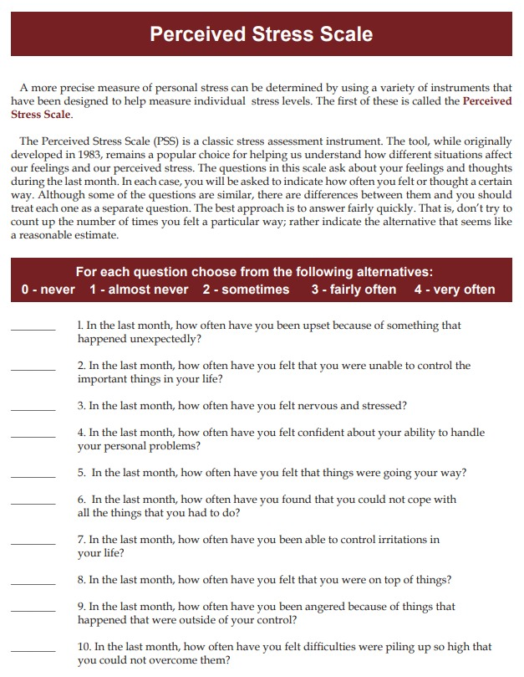
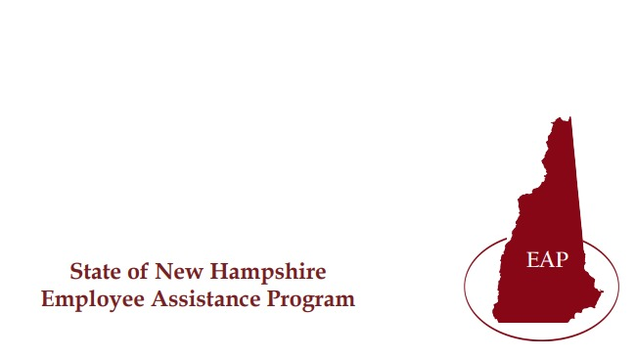
APPENDIX
Questioner to detect stress

Slide 63
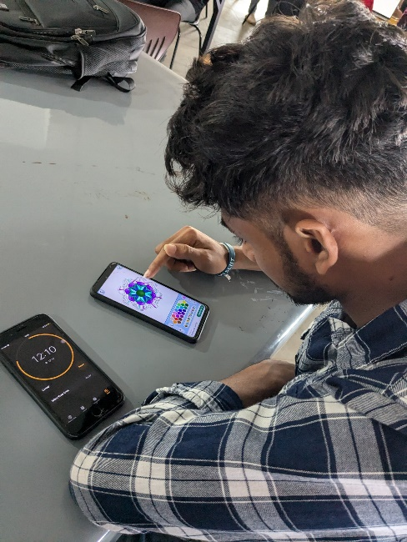
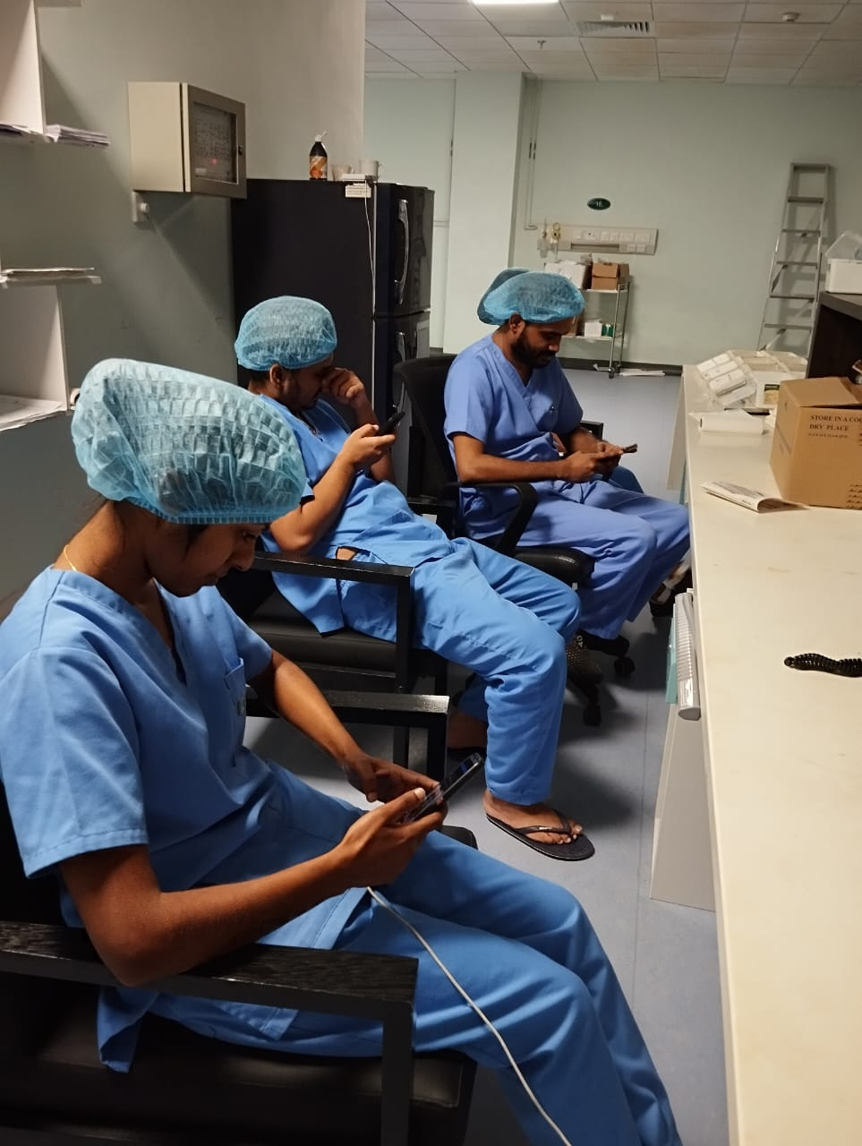
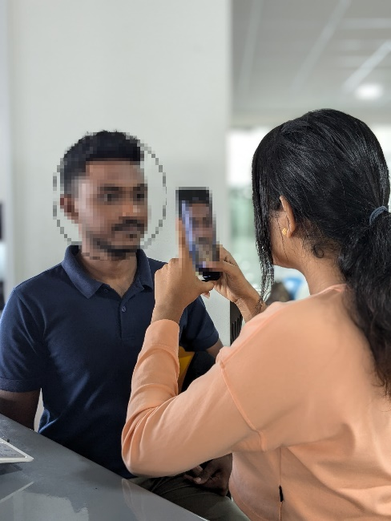
Data & information collection

Slide 64
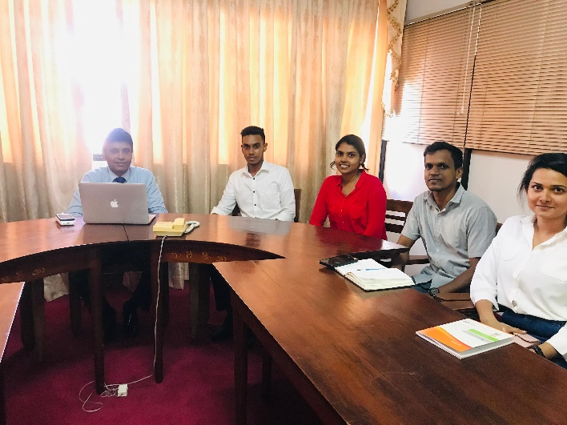
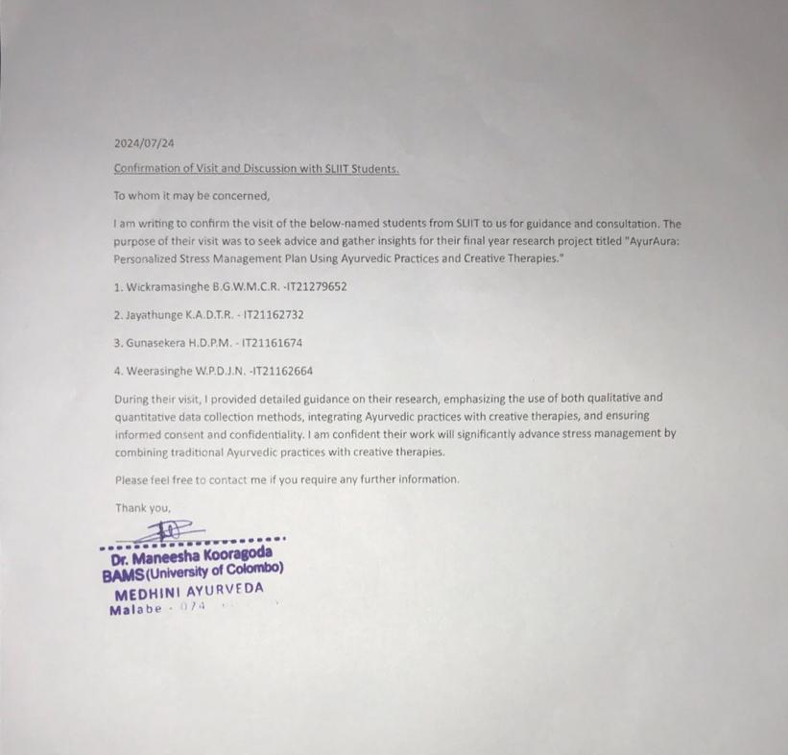
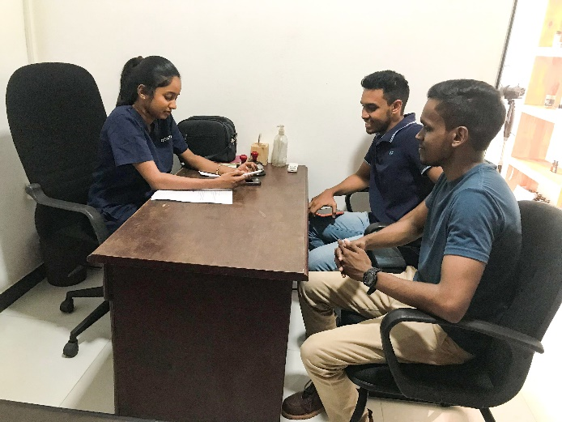

Slide 65
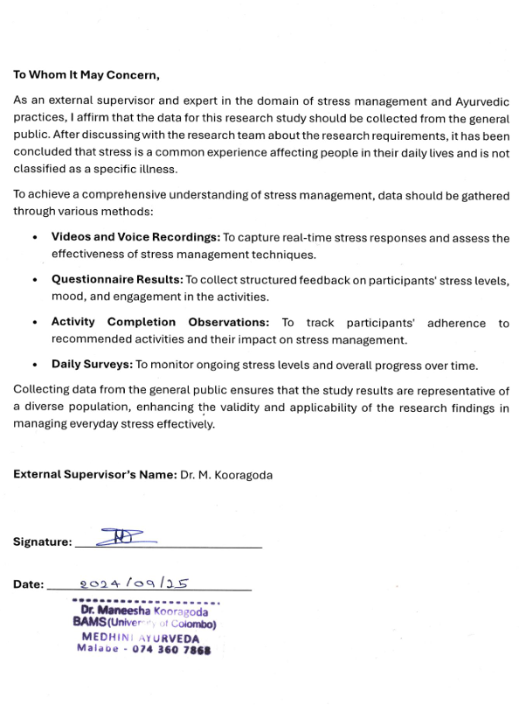
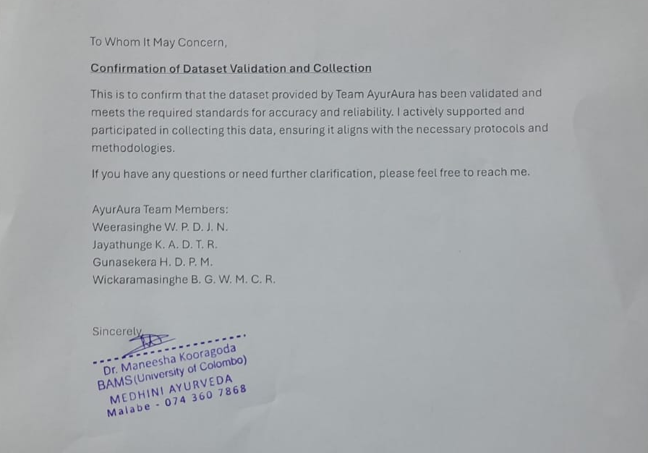

Slide 66



Slide 67

Q & A
Thankyou!!
24-25J-180

